Slide 1
Image Filter
David Ye & Charles Han

Slide 2
Background
Art Students
Special
Effects
User
Friendly
GUI

Slide 3
GUI
Design
Implement

Slide 4
DESIGN
Label 1
Entry
Label 2
Button 1
Listbox
Image
Button 2

Slide 5
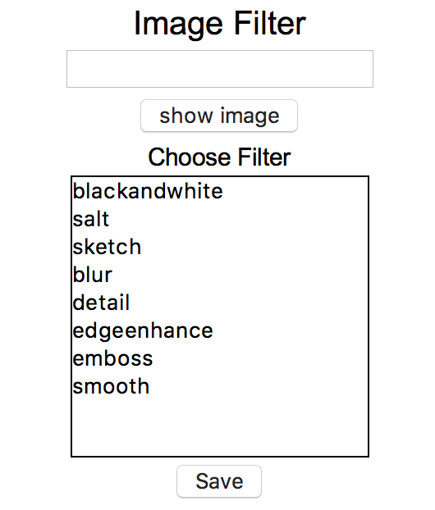
DESIGN
Label 1
Entry
Button 1
Label 2
Listbox
Button 2

Slide 6
Implement
Label 1
Entry
root = Tk() root.title("Image Filter") root.geometry('300x320') Label(root, text='Image Filter', font=('Arial', 20)).pack(side=TOP ) frm = Frame(root) var = StringVar() e = Entry(frm , textvariable = var).pack(side=TOP) Button(frm , text="show image", command = show).pack(side=TOP) Label(frm, text='Choose Filter', font=('Arial', 15)).pack(side=TOP) li = StringVar() lb = Listbox(frm , listvariable = li) li.set(("blackandwhite","salt","sketch","blur","detail","edgeenhance","emboss","smooth")) lb.bind('<ButtonRelease-1>', get_name) lb.pack(side=TOP ) Button(frm , text="Save",command = save).pack(side=TOP ) frm.pack(side=TOP) frm.pack() root.mainloop()
Button 1
Label 2
Listbox
Button 2

Slide 7
Functions
configuration
Image Filter

Slide 8
Configuration
def process(event): a=var.get() image = I.open(a) name=lb.get(lb.curselection()) if name == "blackandwhite": blackwhite(image,0) elif name=="salt": salt(image,0) elif name == "sketch": sketch(image,0) elif name =="blur": blur(image,0) elif name =="detail": detail(image,0) elif name =="edgeenhance": edgeenhance(image,0) elif name == "emboss": emboss(image,0) elif name=="smooth": smooth(image,0)
def save(): a = var.get() image = I.open(a) name = lb.get(lb.curselection()) if name == "blackandwhite": blackwhite(image,1) elif name == "salt": salt(image,1) elif name == "sketch": sketch(image,1) elif name == "blur": blur(image,1) elif name == "detail": detail(image,1) elif name == "edgeenhance": edgeenhance(image,1) elif name == "emboss": emboss(image,1) elif name == "smooth": smooth(image,1)

Slide 9
Image Filter
black &
white
salt
sketch
edge enhance
blur
detail
emboss
Smooth

Slide 10
Evaluate
Corporation
goal
difficulty
Efficient

